Slide 1
Evolution of Mobile Development
World’s Largest Independent
Mobile Ad Network
Mohit Saxena
Technology Founder & VP Technology
InMobi

Slide 2
Mobile Over the Decade
Put Internet back on track
Generated new ecosystems
Caused dominance of social media
Notes:
Mobile application has been the topic for all top stories for an entire decade. It has not only put the somewhat stagnant Internet world back on track, but has also fueled and even generated several new ecosystems around it. Cutting edge mobile development is also responsible for causing the dominance of social media over traditional Internet media because it has taken internet connectivity from people’s office, home and work to their hands where it is closer to their individual personality. It has opened a whole new world of innovative ways of user engagement.

Slide 3
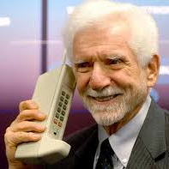
Mobile in 2000
Big and Bulky
Telco Dominated
Only For Calls
Notes:
If I look back 10 years, mobile device was this black miraculous but big device that allowed us to make calls without wires. At that time nobody would have thought that this device would change the world forever over the course of just 10 years. Mobile application development has evolved at an unprecedented rate and there is nothing in the entire digital or Internet realm that comes close to it. In the beginning of the last decade mobile development was entirely controlled by mainly Telcos . Mobile devices were running on slow analog wireless services and user engagement was limited to only making calls.

Slide 4
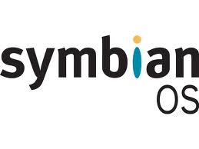
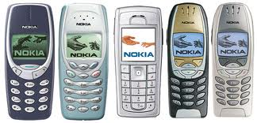
Early – Mid Decade
Greater User Engagement
Apps and Games
Smaller and Lighter
Color Screen
New Mobile App Platforms
Sony, Moto, Nokia etc.
Notes:
Around early-mid decade a mobile chipmaker company named Qualcomm, created an application platform called BREW initially exclusively for CDMA and later on for GSM as well. This was considered the great break through because it led to a greater user engagement, creation of applications and games on the tiny mobile screen.
During the same time mobile devices itself were going through its own evolution where it was getting lighter and thinner. Transition was happening from grey and black screen to color screen. More and more manufacturers like Motorola, Nokia, Sony joined in the revolution and almost all of them created their own mobile application development platform. One such platform was Symbian started by Nokia and later adopted by many other manufacturers including Motorola and Sony. This platform took the whole eco system to new high. It dominated the space for more than 5 years and even now when it is on steep declining curve in terms of adoption, the numbers are big enough in some parts of the world to let it continue to be the largest for quite a while longer.

Slide 5
Business Communication Redefined
Notes:
While the Symbian wave was on the rise, parallel a Canadian company, Research-In-Motion (RIM), launched its own platform with a catchy brand name Blackberry. RIM had given a whole new meaning to the term ‘Business Communication’ by merging it with mobile devices. That was quite a powerful platform that literally liberated the business community from the need of wired PC world for business communication. This was actually the first assertive indication of how powerful a mobile device could be.

Slide 6
Constrained Environment
Still Telco Dominated
Closed IP
Notes:
However the problem was that all these platforms were more or less still within the controls of OEM/ Telcos or were the closed IP of companies like RIM. So creativity was always limited to few people and each one of them were trying to solve one problem at a time so there was never a complete solution.

Slide 7
Game Changing Device Unveiled
Notes:
Within same time frame in Apple launched a compact music player called iPod. That instantly became a phenomenon. It was almost a flawless device with outstanding usability, game-changing looks, all in a compact size. The only thing was missing from this device was that it couldn’t make calls. But the iPod gave the world enough evidence where Apple was heading and raised all kinds of speculations around the mysterious device hoping that it will be a game changed when it comes to mobile devices.

Slide 8
Innovation Continued
Notes:
when Apple finally unveiled iPhone, it became an instant rage all over the world once again because of its simple yet powerful usability, impeccable looks and compact size. It had everything that one could want in a mobile device and more. It was also built on a powerful mobile development platform that almost eradicated the gap between any traditional web development platform and mobile platform that existed at that time. After the launch of iPhone, within a year Apple launched iOS and opened up its platform for mobile developers. In just a few weeks, Apple app store was flooded with as many as 227 apps per week and every app was trying to out do each other in term of usability and engagement.

Slide 9
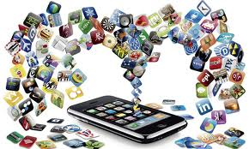
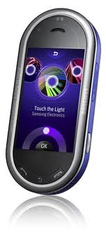
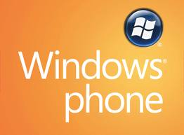
Everyone Joined the Bandwagon
jkfjjssd
Notes:
After seeing this success it was just a matter of time for others to follow suit and join the Mobile Application Development platform bandwagon. Google followed it soon by launching open source mobile development OS and platform called Android. Since it was open source, several mainstream manufacturers who were lacking their own platform that could rival iOS quickly adopted it. Manufacturer like Nokia, RIM and Samsung have also created their own mobile development platform like MeMe, Blackberry and BADA . Microsoft also showed its intention to participate in highly crowded and competitive battle of mobile application ecosystem dominance by launching new mobile development platform Windows Mobile OS7.

Slide 10
Sustained Growth of Mobile Apps
Notes:
There are two ways for mobile application developers to generate revenue from these mobile platforms. First option is a one-time revenue generation through downloads cost but it is not enough to sustain the growth. Second option is to generate constant stream of revenue by creating in-app opportunities either by in-app advertising or in-app direct transactions. In-app advertising is the area where companies like InMobi have a large part to play. To help maintain the growth and success of the application development platform, it is very important for ad networks to be able to help with higher monetization as well as to promote these apps.

Slide 11
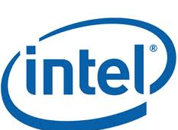
Earn Money with an Ad Network
Advertisers
Ad Networks
Apps
Consumers

Slide 12
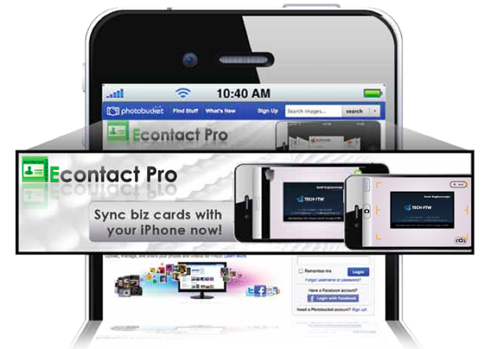
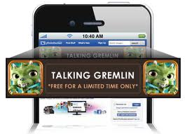
Promote Your App with an Ad Network
Apps
Ad Networks
Publishers
Consumers

Slide 13
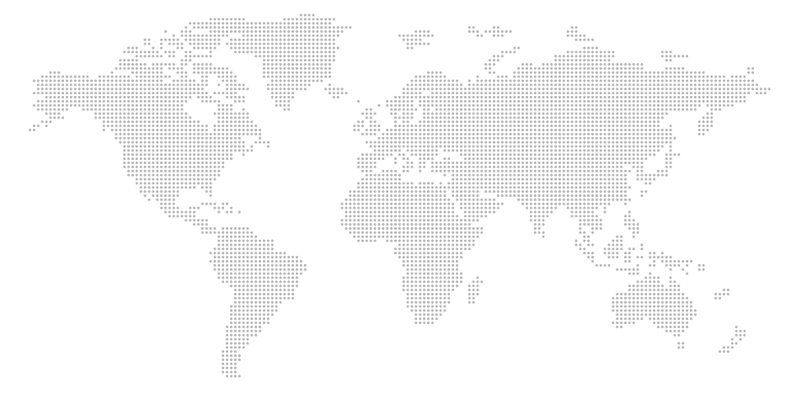
Speed
15,000 ads per second / 20 ms server response time
InMobi Daily Peak:
15,000 ads per second
average is 7,000
Twitter All Time Peak:
World Cup 2010 was
2,940 tweets per second
Vs.
4 Different Server Co-Locations:
North America Europe
India
Japan

Slide 14
32,000,000,000
Ads in January

Slide 15
15000 Ads/ Sec
20 ms per Ad
50 TB Data/month

Slide 16
225,000,000 People
140 Countries

Slide 17
~1,000,000,000,000 Ads
That’s a Trillion!
1,000,000,000 People
That’s a Billion!

Slide 18
4,500,000,000
200,000,000
Mobile Internet Users
Tablets
2014
$60 - $80 bn
Global Mobile Ad Market
2,000,000,000
250,000,000
Smartphones
Mobile Internet Users in India
“First” Screen in All Emerging Markets

Slide 19
Thank you MOHIT SAXENA MOHIT.SAXENA@INMOBI.COM www.inmobi.com
VISIT www.InMobi.com/SiliconIndiaDevs
TO RECEIVE A PROMOTION CODE FOR $50 OF ADVERTISING CREDIT

